Slide 1
Kirchhoff’s laws
Date: 15-07-2020
Module 1: Fundamentals of DC Circuits
EEE 1024 Fundamentals of Electrical and Electronics Engineering

Slide 2
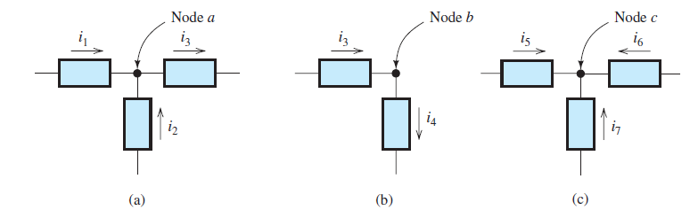

Node
A node in an electrical circuit is a point at which two or more circuit elements are joined together.

Slide 3

Kirchhoff’s laws
Kirchhoff’s Current Law
Kirchhoff’s Voltage Law

Slide 4
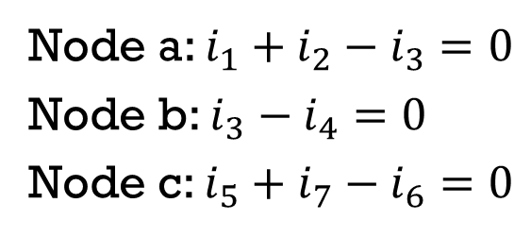
Kirchhoff’s Current Law
Kirchhoff’s current law: The net current entering a node is zero.
To compute the net current entering a node, we add the currents entering and subtract the currents leaving.
Node a: $i_{1}+i_{2}−i_{3}=0$
Node b: $i_{3}−i_{4}=0$
Node c: $i_{5}+i_{7}−i_{6}=0$

Slide 5
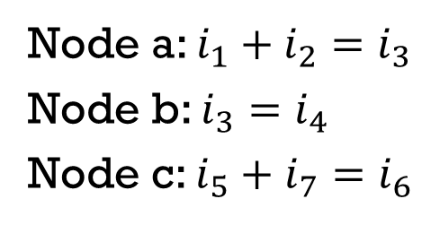
Kirchhoff’s Current Law
We abbreviate Kirchhoff’s current law as KCL.
Another way to state KCL is: The sum of the currents entering a node equals the sum of the currents leaving a node.
Node a: $i_{1}+i_{2}=i_{3}$
Node b: $i_{3}=i_{4}$
Node c: $i_{5}+i_{7}=i_{6}$

Slide 6
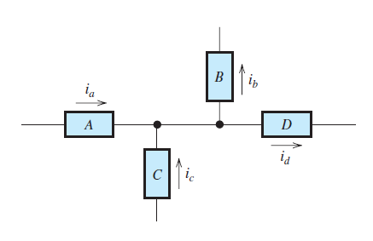
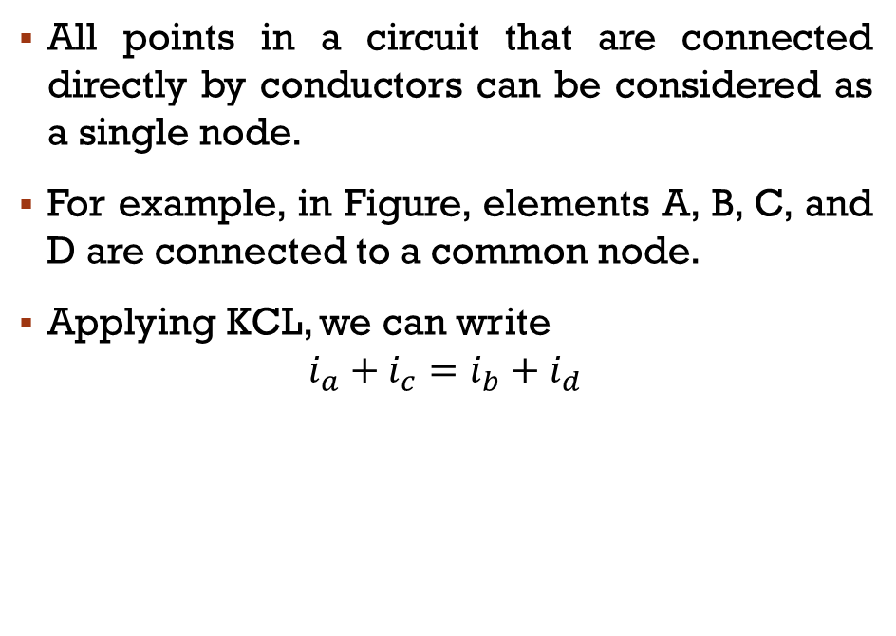
Kirchhoff’s Current Law
All points in a circuit that are connected directly by conductors can be considered as a single node.
For example, in Figure, elements A, B, C, and D are connected to a common node.
Applying KCL, we can write
$$i_{a}+i_{c}=i_{b}+i_{d}$$

Slide 7
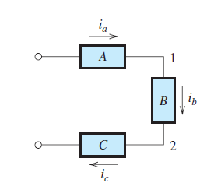
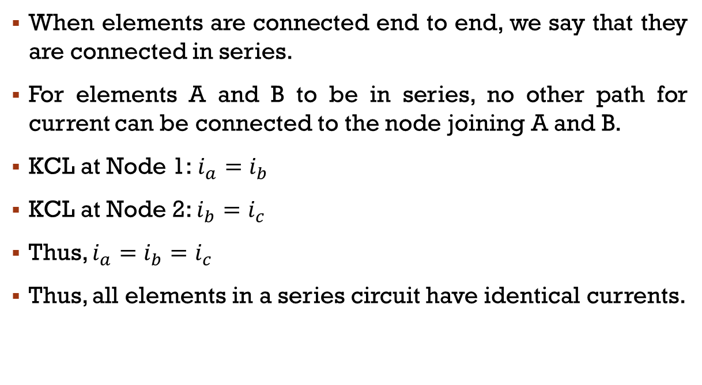
Series Circuits
When elements are connected end to end, we say that they are connected in series.
For elements A and B to be in series, no other path for current can be connected to the node joining A and B.
KCL at Node 1:$i_{a}=i_{b}$
KCL at Node 2: $i_{b}=i_{c}$
Thus, $i_{a}=i_{b}=i_{c}$
Thus, all elements in a series circuit have identical currents.

Slide 8
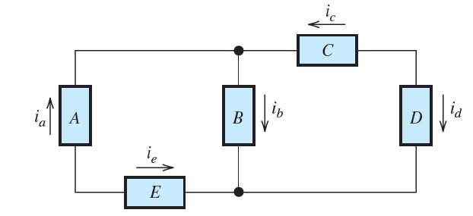
Example: KCL
Which elements are in series?
What is the relationship between id and ic?
Given that ia = 6 A and ic = -2 A, determine the values of ib and id.

Slide 9
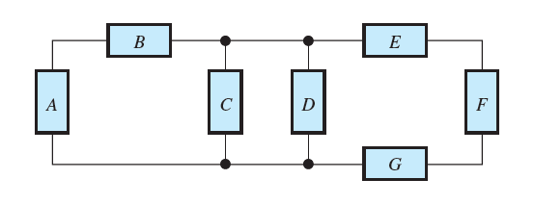
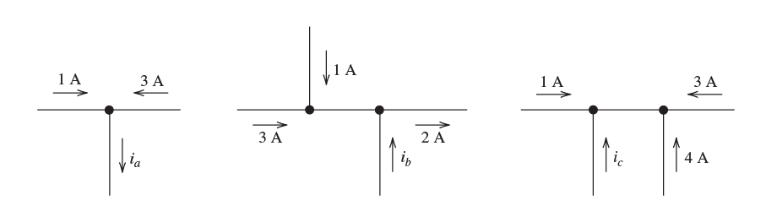
Example: KCL
Identify the groups of circuit elements that are connected in series.
Use KCL to determine the values of the unknown currents

Slide 10
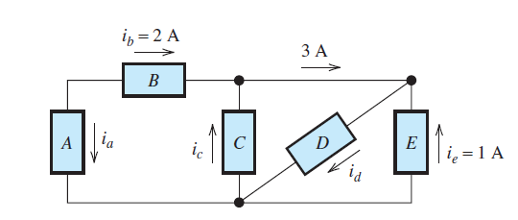
Example: KCL
Find the values of the branch currents using KCL
For the constant node current 3A, what will happen if ‘C’ is removed?

Slide 11
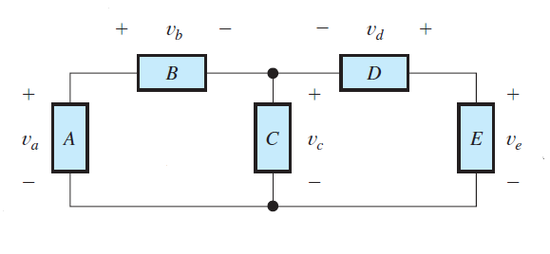
Kirchhoff’s Voltage Law
Loop: A loop in an electrical circuit is a closed path starting at a node and proceeding through circuit elements, eventually returning to the starting node.

Slide 12
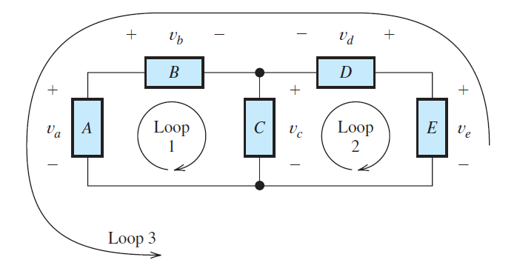
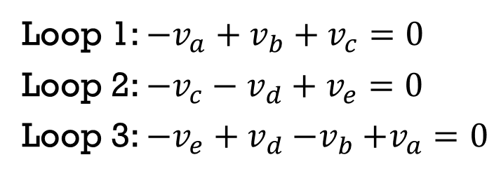
Kirchhoff’s voltage law (KVL)
The algebraic sum of the voltages equals zero for any closed path (loop) in an electrical circuit.
In traveling around a loop, we encounter various voltages, some of which carry a positive sign while others carry a negative sign in the algebraic sum.
A convenient convention is to use the first polarity mark encountered for each voltage to decide if it should be added or subtracted in the algebraic sum.
Loop 1: ${−v}_{a}+v_{b}+v_{c}=0$
Loop 2: ${−v}_{c}−v_{d}+v_{e}=0$
Loop 3: ${−v}_{e}+v_{d}{−v}_{b}+v_{a}=0$

Slide 13
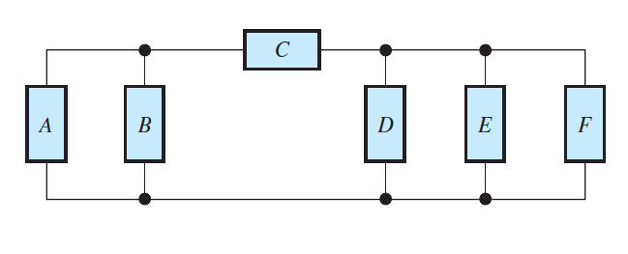
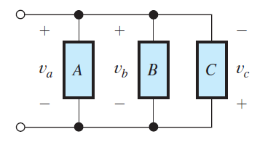
Parallel Circuits
We say that two circuit elements are connected in parallel if both ends of one element are connected directly (i.e., by conductors) to corresponding ends of the other.
Element B is not in parallel with D because the top end of B is not directly connected to the top end of D.

Slide 14
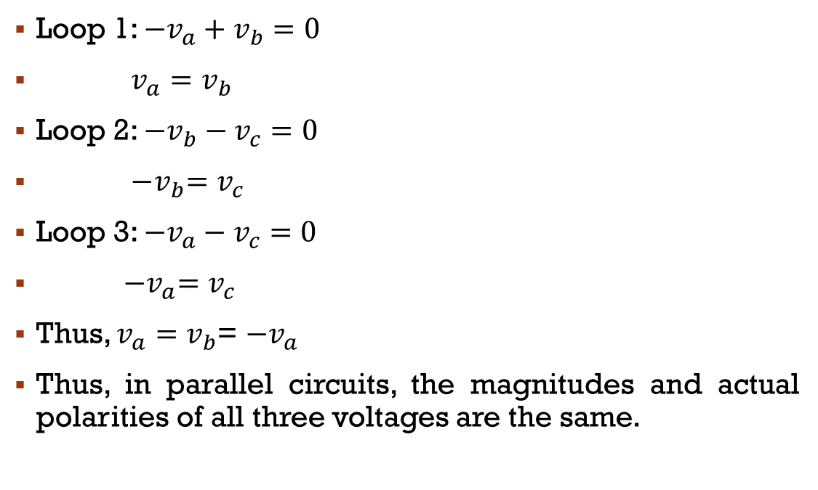
Kirchhoff’s Voltage Law
Loop 1: ${−v}_{a}+v_{b}=0$
$v_{a}=v_{b}$
Loop 2: ${−v}_{b}−v_{c}=0$
${−v}_{b}=v_{c}$
Loop 3: ${−v}_{a}−v_{c}=0$
${−v}_{a}=v_{c}$
Thus, $v_{a}=v_{b}$= ${−v}_{a}$
Thus, in parallel circuits, the magnitudes and actual polarities of all three voltages are the same.

Slide 15
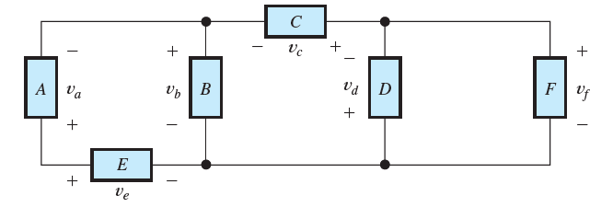
Example: kvl
Which elements are in parallel?
Which elements are in series?
What is the relationship between vd and vf?
Given that va = 10 V, vc = 15 V, and ve = 20 V, determine the values of vb and vf.

Slide 16
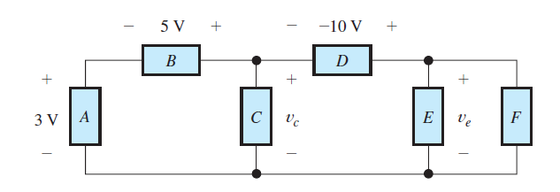
Assignment 2: kvl
Identify the elements that are in parallel
Identify the elements that are in series
Find the values of vc and ve

Slide 17
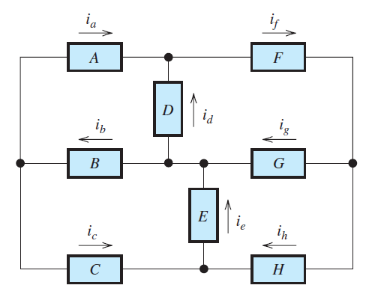
Assignment 3: KCL & kvl
Find the values of the other currents in Figure, if ia = 1 A, ib = 2 A, id = -3 A, and ih = 5 A.

Slide 18
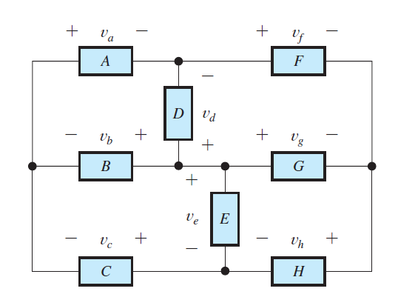
Assignment 4: KCL & kvl
Solve for the other voltage shown in Figure, given that va = 10 V, vb = 8 V, vf = -5 V, and vh = 2 V.

Slide 19
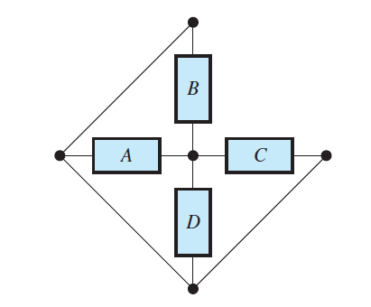
Thank you ☺
Nodes?
Elements in Parallel?
Elements in Series?

